Slide 1
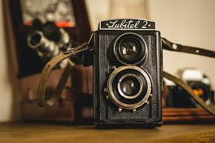
Congrulations’ Old camera is yours This the camera very old is gives us simple photo it is an show piece now

